Slide 1
The Enlightenment in Europe

Slide 2
Objectives
Explain the ideas of Hobbes and Locke and other Enlightenment philosophers
Describe women and the Enlightenment
Explain the legacy of the Enlightenment

Slide 3
What was the Enlightenment?
A new intellectual movement that stressed reason and thought and the power of individuals to solve problems
Gave new insight on:
Government
Religion
Economics
Education

Slide 4
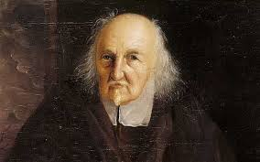
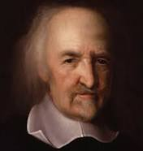
Two views on Government
Thomas Hobbes wrote his views in his work called Leviathan in 1651
Without government to keep order then:
- “war…of every man against every
man.”
Life would be:
- “solitary, poor, nasty, brutish, and
short.”

Slide 6
Two Views on Government
Hobbes belief: The Social Contract
People must hand over their rights to a strong ruler in order to escape a miserable life.
Ruler needed total power to keep citizens under control
Government was an absolute monarchy
Could impose order and demand obedience
Best Government has the power of a Leviathan
Sea Monster

Slide 7
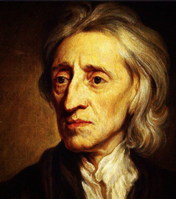
John Locke
Self Government:
People could learn from experience and improve themselves
People have a natural ability to govern their own affairs
People can look after the welfare of society

Slide 8
John Locke
People were born free and equal with 3 natural rights:
- Life, Liberty, and property
Governments purpose is to protect these rights, if they fail to do so, then the people can overthrow the it.
-Foundation of modern democracy
Notes:
1776- Thomas Jefferson changed this phrase to happiness in the Declaration of Independence

Slide 9
Thomas Hobbes
John Locke
Humans were naturally selfish and wicked
Humans were reasonable, could learn and grow
Absolute Monarchy
Self Government
Modern Democracy

Slide 10
Enlightenment Spreads
Paris, France became the center of the enlightenment movement
Philosophes- French word for philosophers
Applied reason to all aspects of life
Reason- Truth can be discovered through logical thinking
Nature- what is natural is also good and reasonable
Happiness- can be found on earth not just in heaven
Progress- society and humankind can improve
Liberty- the want for the same liberties the English people won in Revolution and Bill of Rights

Slide 11
Voltaire
Francois Marie Arouet
Published over 70 books of political essays, philosophy, and drama
Main goal: Freedom of thought and expression
His sharp tongue and witty remarks got him sent to jail twice and exiled to England
“ I do not agree with a word you say but will defend to the death your right to say it.”

Slide 12
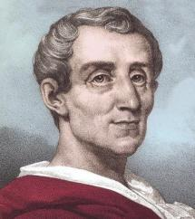
Baron De Montesquieu
Devoted to study of political liberty and the separation of powers
Believed that Britain had the most politically balanced country
King<- Executive power (carried out the laws)
Parliament<- Legislative power (made laws)
Judges <- Judicial power (interpreted the law)
On the Spirit of Laws (1748)
Separation of power
Checks and balances
Basis for the United States Constitution

Slide 13
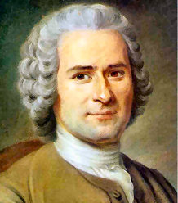
Jean Jacques Rousseau
Devoted to the study of individual freedom
The Social Contract (1762)
Only goof government was one freely formed by the people and guided by the “general will” of society.
Direct Democracy
All people were equal and that titles of nobility should be abolished
French Revolution

Slide 14
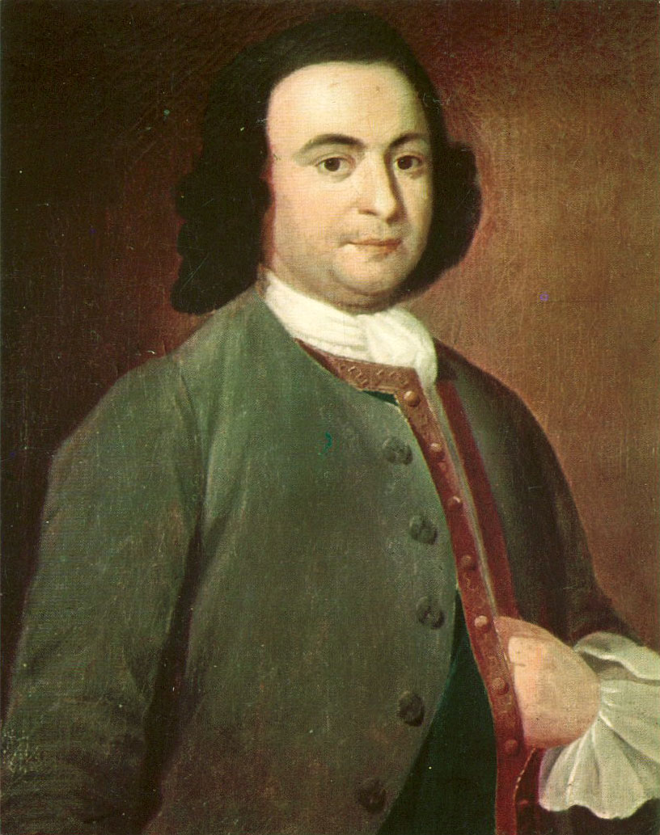
Cesare Bonesana Beccaria
Devoted his study to the judicial system
Governments should seek the greatest good for the greatest number of people
Influenced criminal law reformers in Europe and North America
Laws exist to preserve social order, not to avenge a crime
Accused person should have speedy trail without torture
Punishment based off the crime
Abolish capital punishment

Slide 15
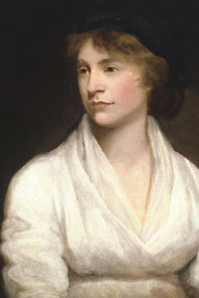
Mary Wollstonecraft
Devoted her study to women’s equality.
A Vindication of the Rights of Woman (1792)
Women, like men, need education to become virtuous and useful
Urged women to enter the male-dominated fields of medicine and politics.
Current Women Statistics
Percent of women doctors 32.4%
Percent of women in law 33.4%
Percent of women CEOs 4.6%
-at S&P 500 companies
Percent of women in US workforce 47%
-there are nearly twice as many
women than men in the United
States

Slide 16
Legacy of the Enlightenment
Belief in Progress- Once the door had been opened on new philosophies and ways of thinking, it paved the way for other new discoveries both scientifically and socially.
Rise of Secularism- people began to question the beliefs and teachings of the church and favored scientific reasoning.
Rise of Individualism- people used their own sense of reason to judge what was right and wrong both politically and socially.

